Slide 1
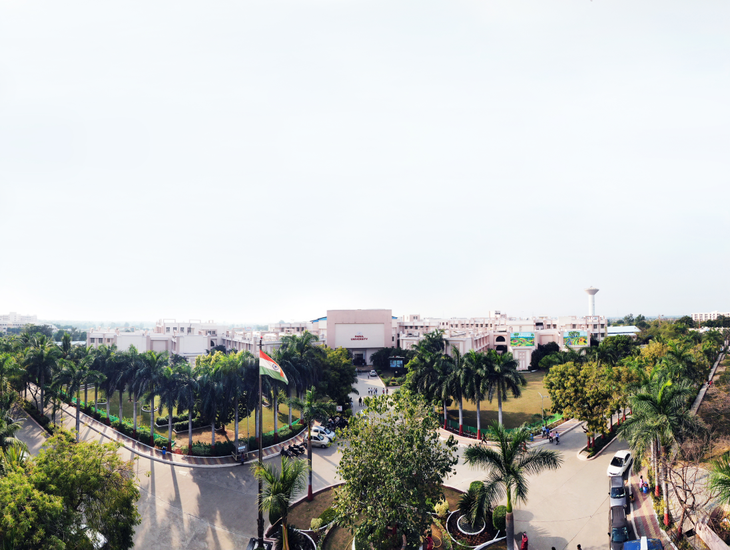


Python Programming Workshop - 1 (Experiments)
Dhruvi Marsonia, Assistant Professor
Computer Science and Engineering, PIT

Slide 2
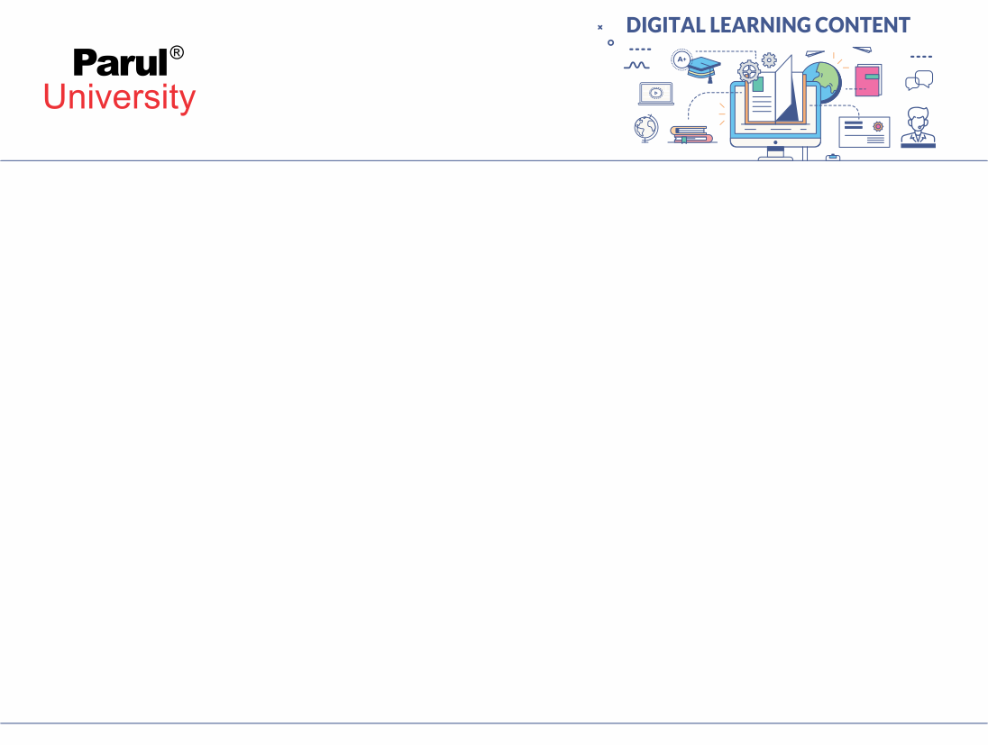

Practical-1
Introduction to Python

Slide 3
Aim: Introduction to Python.
Objectives: To Understand basic concepts of Python.
Apparatus/Components: Text Editor or any IDE with python compiler or any Online python compiler with internet

Slide 4
Prerequisites
What is Python?
Installation of the python environment (anaconda).
Python keywords, comments, and indentation.
Python data types.
Math and numbers in python.

Slide 5
A. What is Python?
Python is a popular object oriented high level programming language. It was created by Guido van Rossum, and released in 1991. It is used for following purposes:
web development (server-side).
software development.
Mathematics.
system scripting.

Slide 6
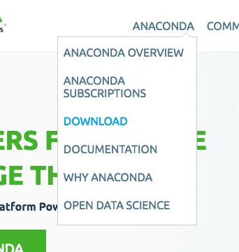
B. Installation of Python Environment
1. Download Anaconda
1. Visit the Anaconda homepage.
2. Click “Anaconda” from the menu and click “Download” to go to the download page.

Slide 7
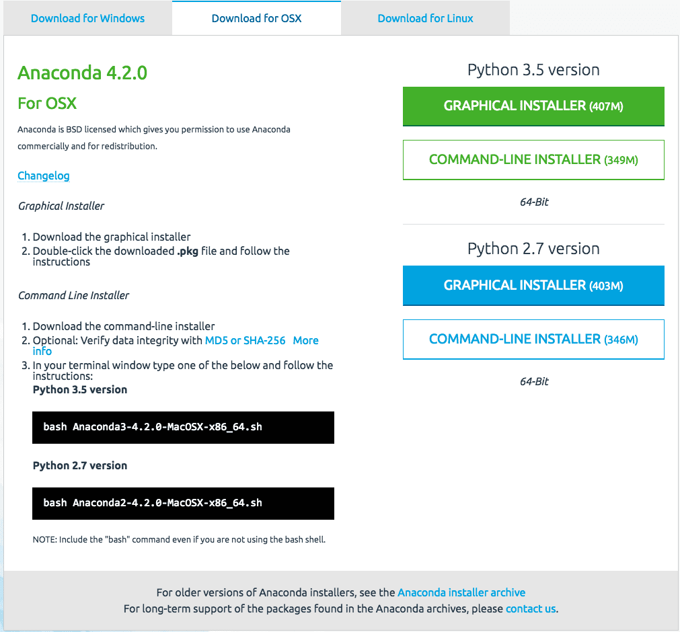
3. Choose the download suitable for your platform (Windows, OSX, or Linux):
Choose Python 3.5
Choose the Graphical Installer

Slide 8
4. This will download the Anaconda Python package to your workstation.
I’m on OS X, so I chose the OS X version. The file is about 426 MB.
You should have a file with a name like:
Anaconda3-4.2.0-MacOSX-x86_64.pkg

Slide 9
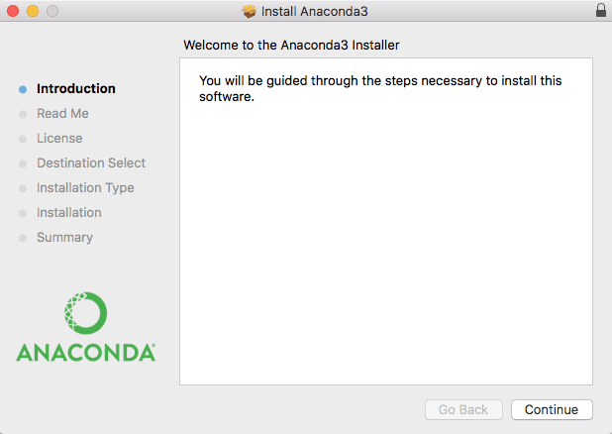
Installation of Python Environment
2. Install Anaconda
This step assumes you have sufficient administrative privileges to install software on your system.
1. Double click the downloaded file.
2. Follow the installation wizard.

Slide 10
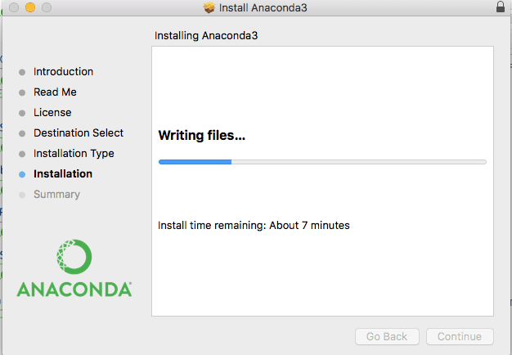
Installation of Python Environment
Installation is quick and painless.
There should be no tricky questions or sticking points

Slide 11
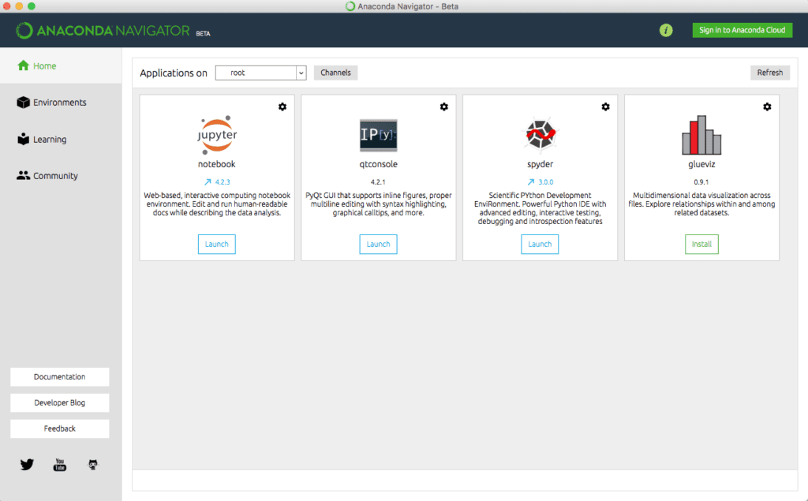
Installation of Python Environment
3. Start and Update Anaconda:
Anaconda comes with a suite of graphical tools called Anaconda Navigator. You can start Anaconda Navigator by opening it from your application launcher.

Slide 12
C. Python keywords, comments, and indentation.
Python Keywords
Keywords are the reserved words in Python. We cannot use a keyword as a variable name, function name or any other identifier. They are used to define the syntax and structure of the Python language.
In Python, keywords are case sensitive. There are 33 keywords in Python 3.7. This number can vary slightly over the course of time.
All the keywords except True, False and None are in lowercase and they must be written as they are. The list of all the keywords is given below. Anaconda comes with a suite of graphical tools called Anaconda Navigator. You can start Anaconda Navigator by opening it from your application launcher.

Slide 13
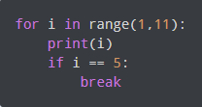
C. Python keywords, comments, and indentation.
Python Indentation:
Most of the programming languages like C, C++, and Java use braces { } to define a block of code. Python, however, uses indentation.
A code block (body of a function, loop, etc.) starts with indentation and ends with the first unindented line. The amount of indentation is up to you, but it must be consistent throughout that block. Generally, four whitespaces are used for indentation and are preferred over tabs.

Slide 14


C. Python keywords, comments, and indentation.
Python Comments:
In Python, we use the hash (#) symbol to start writing a comment.
It extends up to the newline character. Comments are for programmers to better understand a program. Python Interpreter ignores comments.

Slide 15
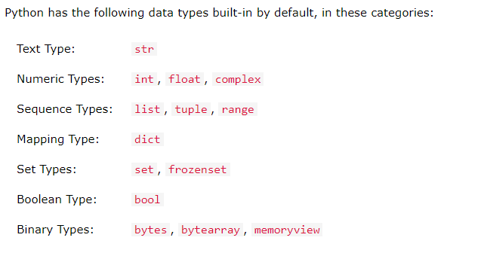
C. Python Data Types
In programming, data type is an important concept.
Variables can store data of different types, and different types can do different things. It extends up to the newline character. Comments are for programmers to better understand a program. Python Interpreter ignores comments.

Slide 16
C. Math and Numbers in Python
Numbers in Python
In Python we have 6 basic mathematical operators, they are:
Addition
Subtraction
Multiplication
Division
Modulo
Power

Slide 17
C. Math and Numbers in Python
Math Functions in Python
In python, there are two types of pre-defined functions:
Inbuilt functions: These are the functions which doesn't require any other(external) code file (known as, Modules or Library Files).
The second type of functions require some external files(modules) in order to be used. The process of using these external files in our code is called importing. So all we have to do is import the file into our code and use the functions which are already written in that file.

Slide 18
Procedure
Step 1: Open python integrated IDE.
Step 2: import module.
Step 3: Perform basic math operations..
Step 4: Print the result.

Slide 19
Program Demonstration

Slide 20



www.paruluniversity.ac.in

